Slide 1

Development
All essays need to have enough detailed evidence and support to prove the thesis.

Slide 2
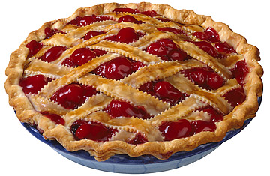
P.I.E. Paragraph
One of the best ways to achieve paragraph development is by implementing the P.I.E. structure.
Point – Topic Sentence (one sentence)
Information/Illustration – A concrete example or quote that proves the topic sentence (many sentences)
Explanation – Explains how the information support the topic sentence and analyzes the connection.

Slide 3
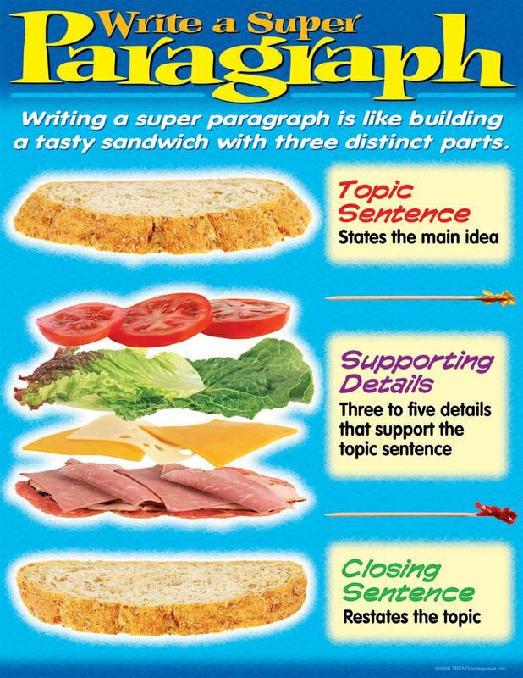
PIE is like a Sandwich

Slide 4

Practice
Examine paragraph 15 in Martha Fay’s “Sedated by Stuff.”
What parts of the paragraph are the Point, Information, and Explanation?
Is the paragraph missing any parts?

Slide 5
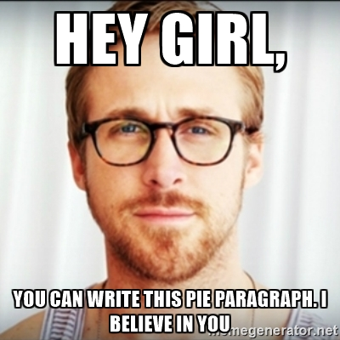
Practice
PIE paragraph exercise on page 28
Read the completed example 3rd PIE Paragraph
Choose the incomplete #1 or #2 paragraphs and add the information and explanation to create development.

Slide 6
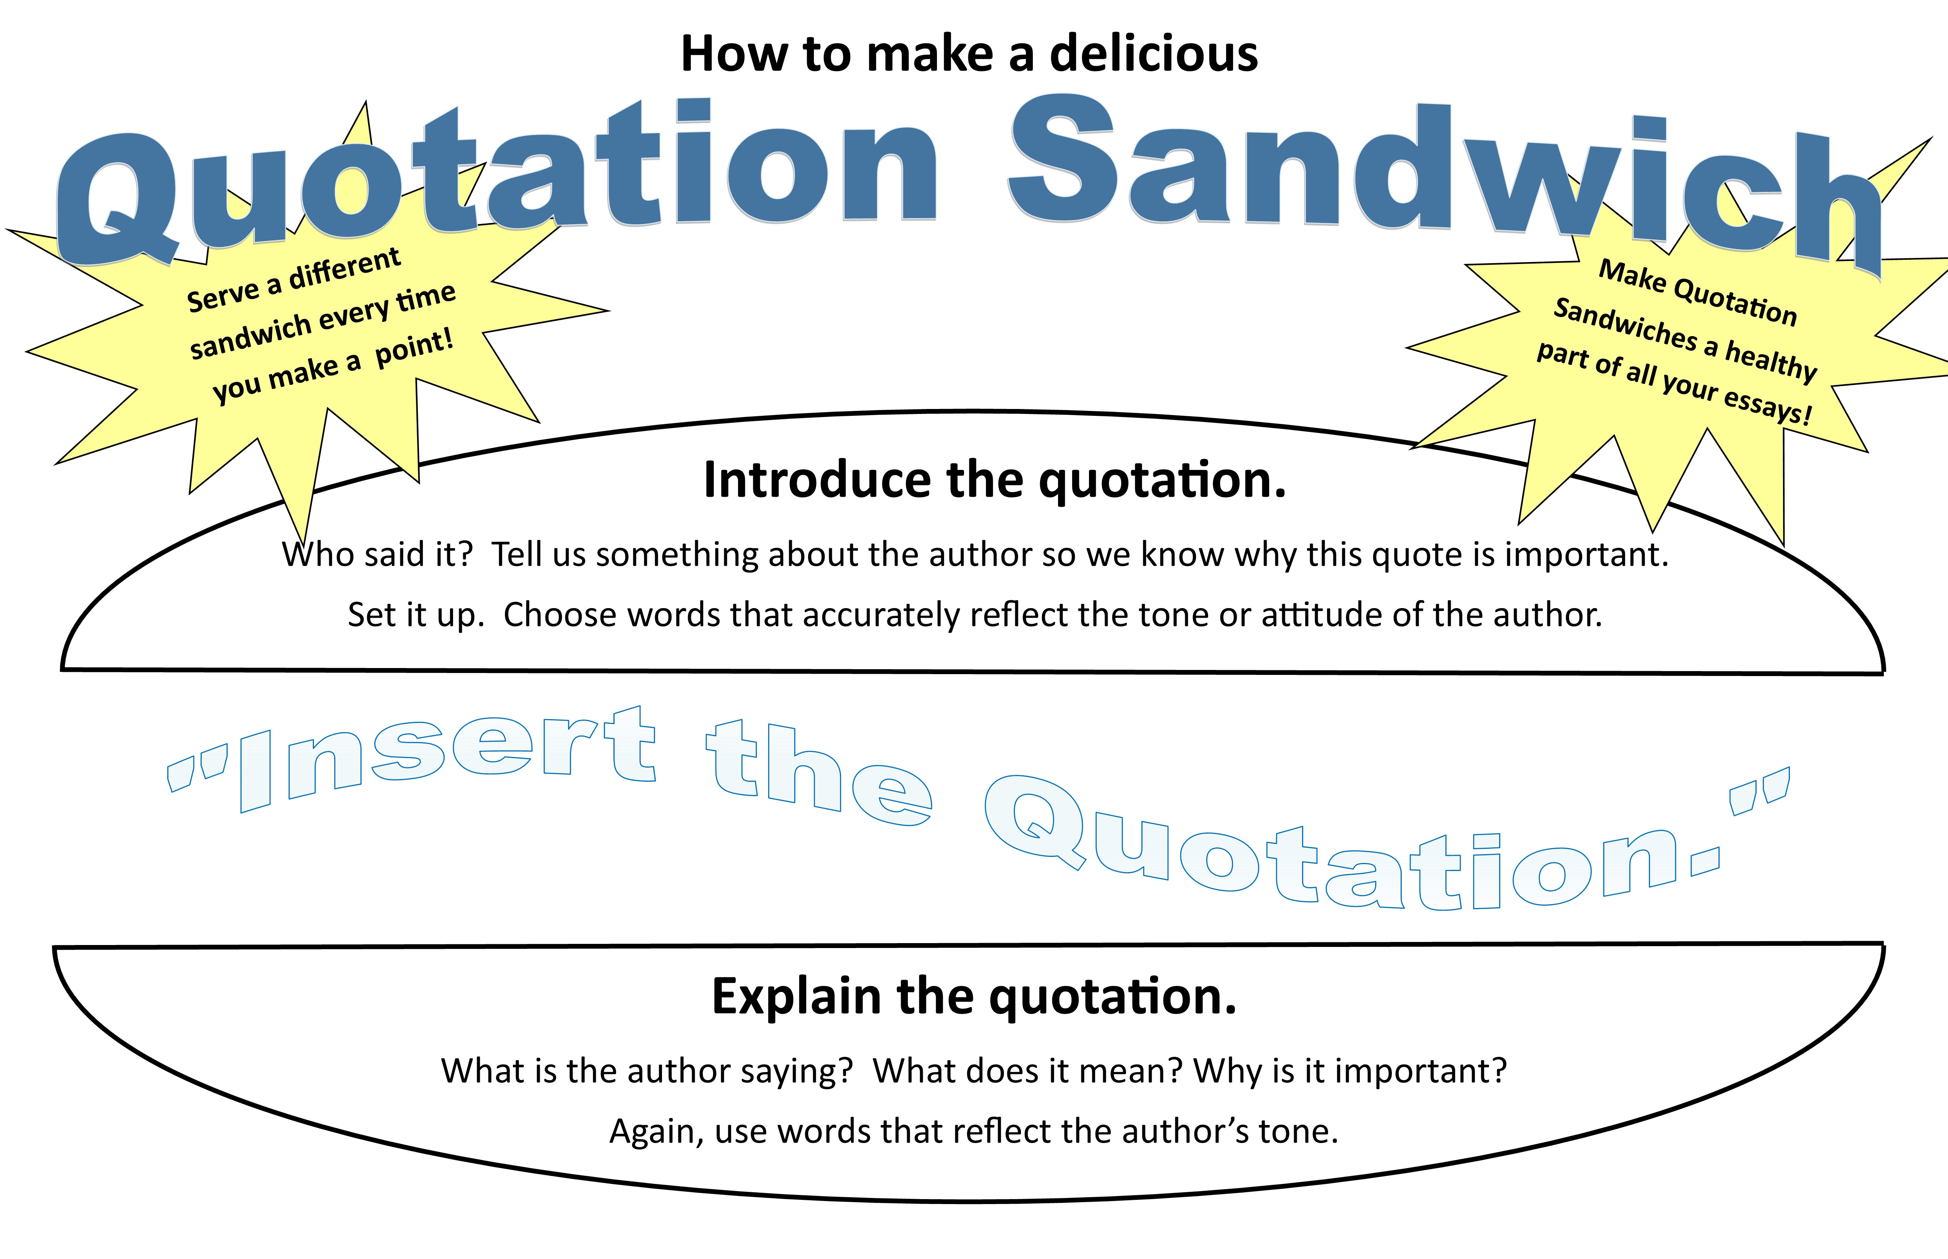
Quote Sandwich
The Information/Illustration could also be a quote to prove the topic sentence. If you use a quote, make sure to introduce it, state it in quotation marks, then explain how the quote proves the point.

Slide 7
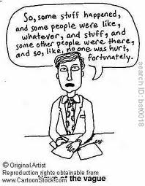
Specific is Terrific
Well developed ideas give a very detailed picture in the readers head.
Avoid using vague language
Example: Things, Stuff
Practice:
Nouns: Shirt, Home, Dog
Verbs: Walk, Eat, Talk, Laugh

