Slide 1

Class Calendar
Today Tues Apr. 25
  Finish Label Lecture
  Gastro-Intestinal Tract (GI Tract)
Thurs. Apr. 27
  Finish GI Tract
  Supermarket Savvy
  Exam 1 Review Sheet posted
Upcoming:
  Exam 1 Tues. May 2

Slide 2
In ‘n Out
The Gastro-Intestinal (GI) Tract

Slide 3
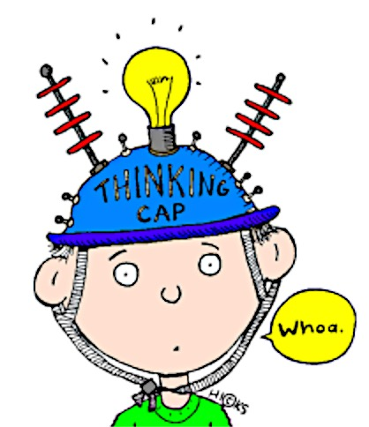
True (T) or False (F)
Indigestion and ulcers result when the stomach is acidic.
It is important to cleanse the GI tract regularly.
3 All carbs (starch/sugar) travel as glucose in blood.
4. The absorptive surface of the small intestine is
about the area of our classroom.
5. The primary site of nutrient absorption is through the wall of the stomach into the blood.

Slide 4
We are what we eat!
We are made of trillions of cells
Cells keep us alive
Cells are living. They;
  Require Oxygen and EN’s to do their jobs
    EN=Carb, Protein, Lipid, Vitamins, Minerals, Water
  Synthesize proteins to do their work
  Work cooperatively to keep us alive
Notes:
Many steps are left out of the slide description of how cells keep us alive!
Proteins made according to the code in our DNA (contained in the chromosomes in the cell nucleus) basically do the work of living cells.
More on this when we talk about protein and proteins are made.

Slide 5
How does food becomes you?
Consumption
Digestion
Absorption
Transport
Metabolism
Notes:
You are what you eat. We are made of about 100 trillion cells, none of which have anything to do with food. Yet, they are living and so must be fed. The cellular environment is watery, so water is required. Plus they need fuel and oxygen to allow them to burn the fuel.

Slide 6
The Fun Part
FOOD CONSUMPTION

Slide 7
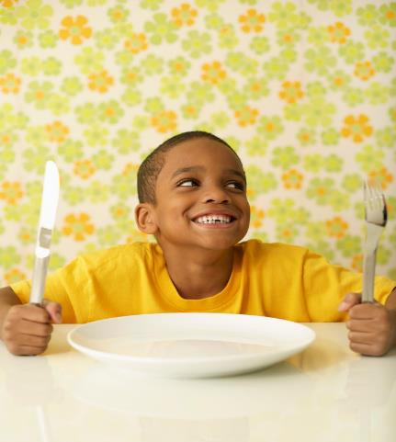
What factors
influence your
food choices?
Notes:
Discuss with neighbors and write on board to share
Availability Beliefs Convenience Cost Culture Education Habit Family Health Hunger→ taste, aroma, appearance, companions Mood…etc.

Slide 8
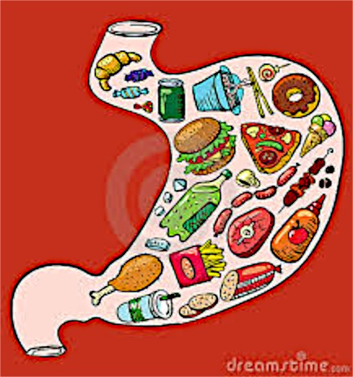
Digestion
Primary purpose: break food into basic
components for absorption into blood and
act as a gatekeeper to the blood
Notes:
Digestion: The process of breaking down food into its component parts so that these components can be absorbed into the blood for transfer to all parts of the body.
It is NOT the job of the GI tract to make ATP for the body. Cells do this for themselves from the nutrients released into the blood a a result of digestion. Once the nutrients reach the cell, the cells can do many different things with them…use the nrg nutrients to make ATP, use the nutrients to build molecules the cells need and ….if the calories delivered are in excess of needs, then the extra calories will be converted to fat and stored as body fat (a.k.a. storage triglyceride)

Slide 9
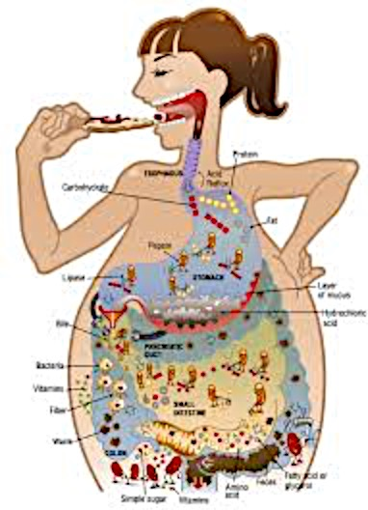
The Food Tube-Gastrointestinal Tract (GI)
  Runs through the body
  Gatekeeper to the blood
  Whole foods→component parts
    Proteins →?
    Fats/Oils →?
    Carbs→?
    Vits, Mins, Water→?
Notes:
GI is 1st line of defense against ‘bad stuff’ in the real world non-food, poison, disease, etc.
GI is dirty (as are the feces), Blood is sterile (as is urine)
Component parts=ENs
Carb→ glucose
Protein→ amino acids
Fats/Oils→ specially packaged (as a type of lipoprotein, called chylomicrons. Other lipoproteins include, LDL and HDL often referred to as bad and good cholesterol, respoectively)

Slide 10
The Food Tube-Gastrointestinal Tract (GI)
  Runs through the body
  Gatekeeper to the blood
  Whole foods→component parts
    Proteins → amino acids
    Fats/Oils → fatty acids + glycerol (specially packaged)
    Carbs→ glucose
    Vits, Mins, Water→ basically… as is

Slide 11
The Action Packed GI Tract
Mechanical
Chemical
Relevant terms
Reverse peristalsis
Emulsification
Denaturation
Hydrolysis
Chewing
Peristalsis
Emulsifiers
Bases
Water
Enzymes (nz)
Acids
Stomach acids can burn skin!
The Cookie Baker YouTube
A practical application of some of these terms.
Notes:
Peristalsis…rhythmic muscle contractions moving food down the GI tract…even if you stand on your head!
Acids in stomach are very low pH (acidic and would burn your skin…stomach has a protective lining. If lining damaged→ ulcers develop. Acids (and heat) ‘denature’ (change) proteins irreversibly which is an important step in digestion
Proton pump inhibitors/ H2 inhibitors/tums (antacids)
YouTube https://www.youtube.com/watch?v=b20VRR9C37Q

Slide 12
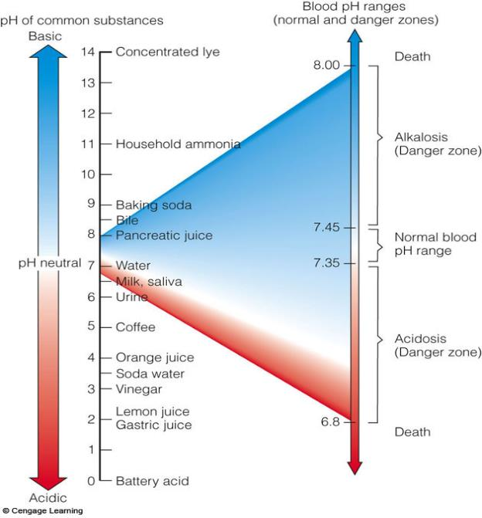
pH Scale
Overview
Fig. 3-11, p. 82
Notes:
Figure 3.11: pH Values of Digestive Juices and Other Common Fluids.
A substance’s acidity or alkalinity is measured in pH units. Each step down (14 high to 1 low) the scale indicates a tenfold increase in concentration of hydrogen particles, which determine acidity. For example, a pH of 2 is 1,000 times stronger than a pH of 5.

Slide 13
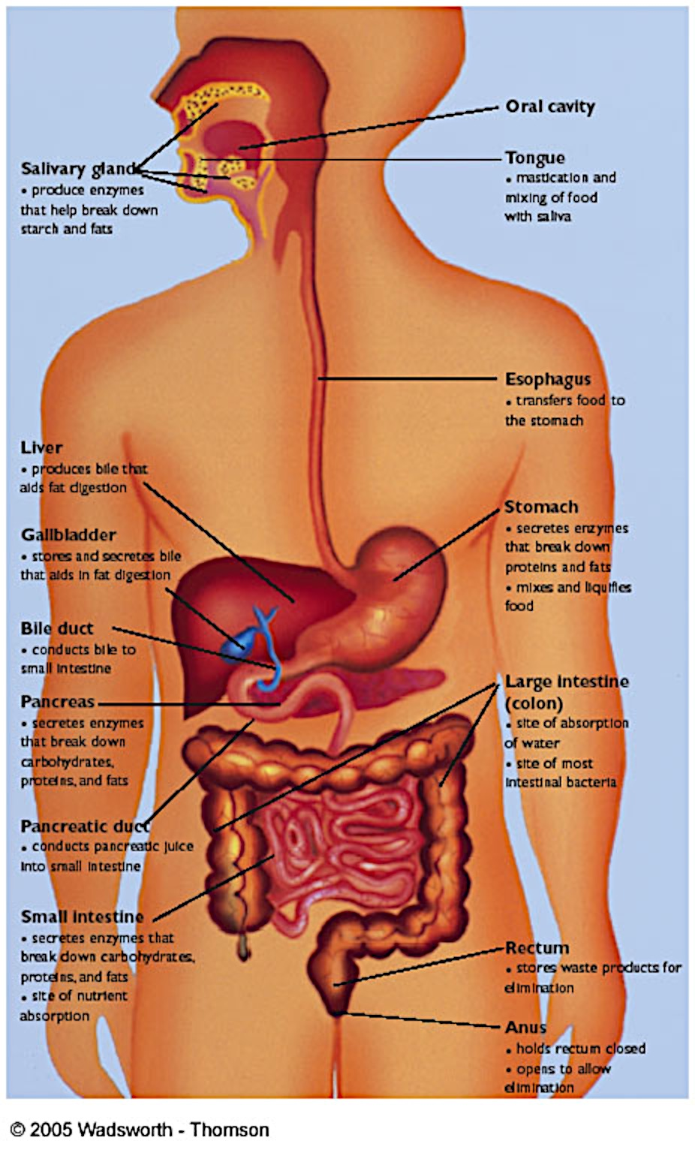
In ‘N Out
→How long does this ‘trip’ take?
~ 30’ long muscular tube,
nerves, secretory organs
Mouth, Esophagus, Stomach
Small Intestine (SI)
Large Intestine (LI)
Rectum/Anus

Slide 14
Ready. Set. Go!
~24 hour trip!
A minute in the mouth : (
~ 1-2 hrs. in the stomach!!
~7-8 hrs. in SI
  #1 site of absorption
~12-14 in LI
Notes:
NO food stays in a healthy body/stomach for weeks or even days, including gum!
Food in mouth ~ 1 minute….if you are a slow eater
Esophagus….seconds to swallow; Choking is when food accidentally goes into the ‘wrong’ pipe called the trachea (wind pipe→ to lungs). Don’t talk and eat at the same time!
Stomach ~1-2 hour
SI 7-8 hours- most digestion occurs here
LI 12-14- most water absorption occurs here

Slide 15
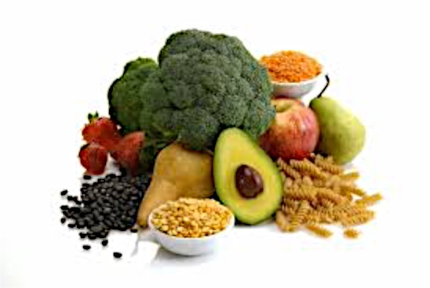
Choices to Shorten Trip In ‘n Out
High fiber plant-based foods shorten the trip!
Meat/eggs/cheese/dairy have NO fiber;
lengthen travel time thru the GI!
(animal-based foods)
Notes:
What makes transit time from IN to OUT more quick? Fiber, ideally from whole foods. Avocado has fiber, but not as much as many other fruits/veg.
NO food stays in a healthy body/stomach for weeks or even days, including gum!

Slide 16
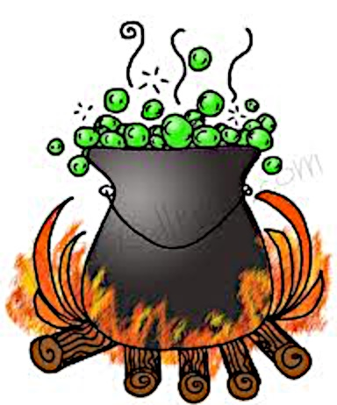
Digestive Brew Hastens SI Action
Liver→ makes bile to emulsify lipids
Gall Bladder→concentrate/store/secrete bile
Pancreas →make/secrete digestive nz
SI →make digestive nz and other chemicals
Notes:
nz= enzymes
What survival advantage did our storage depot of bile found in the gall bladder offer to our hunter-gatherer relatives? Is this still an advantage?

Slide 17
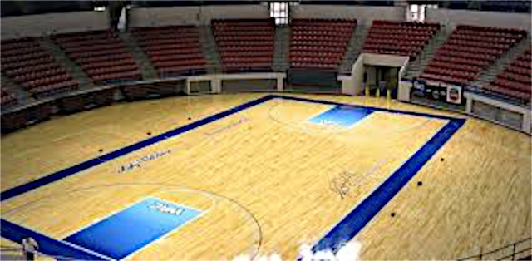
Small Intestine
….isn’t small !!!
Why is SI #1 site of nutrient absorption?
Area ~size of basketball court
Digested nutrients move into bloodstream
Heart pumps blood/nutrients to/from cells
Notes:
What is bariatric surgery and how is it related to GI anatomy?

Slide 18
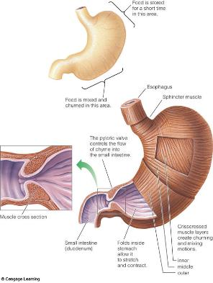
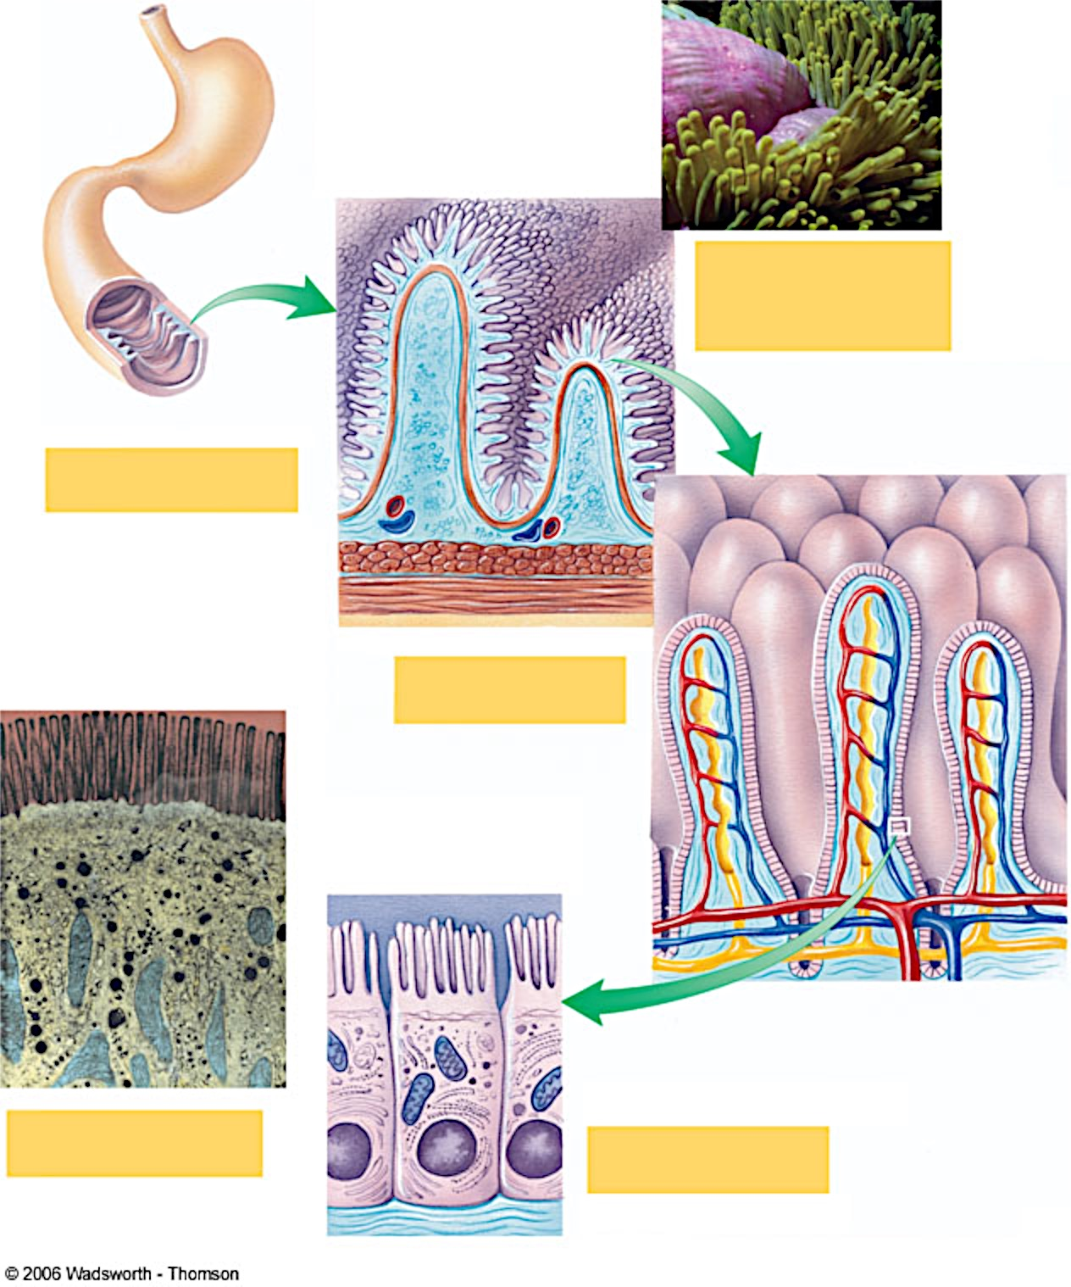
A Closer Look at the SI
Fig. 3-10, p. 81
Notes:
If you eat a nutrient…. Count on it being absorbed into the blood.

Slide 19
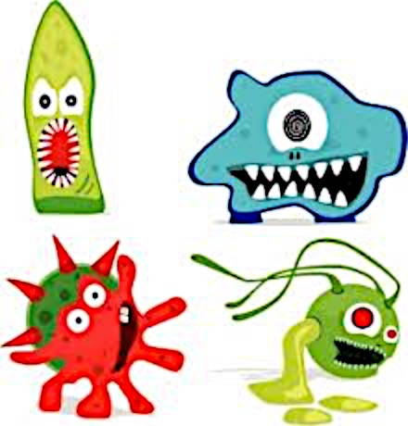
Large Intestine (LI)
What are
Prebiotics?
#1 site water re-absorption
Good LI bacteria make ~Vit K
  Probiotics=healthy bacteria
Bad bacteria cause sickness
What’s not absorbed and excreted as waste?
  Bacteria; healthy GI tract isn’t clean/sterile!
  Fiber; ↑ fiber ↓ transit time
Notes:
Prebiotics (below ) promote growth of (act as a food source of) good bacteria (e.g fiber) Probiotics are the healthy bacteria in the GI tract. Bacterial balance in Gi increasingly being linked to health. Fecal transplants from person with healthy GI to person with GI disease has met with success.
Prebiotics is more or less the food (usually some type of fiber…resistant starch, fructans fructo-oligosaccharides, maybe even inulin-chicory root a popular (not yet proven effective) way to fortify products with fiber) for the probiotic good bacteria

Slide 20

Nutrient Roadmap
What’s next?
Consume food
Digest food
Absorb nutrients
Transport to cell
Metabolism: sum of cell actions
Notes:
Metabolism is basically what happens inside the cells e.g. make ATP, build ‘stuff’ such as proteins, muscle, hair, insulin, blood, etc. and store fat if calories are in excess of need, etc.

Slide 21

Nutrient Metabolism
Part of total cell metabolism
List cells products of nutrient metabolism
  ATP…the form of energy cells use
  metabolic waste…return to blood to excrete
  cell-specific ‘stuff’….to run the body
  fat…made, if have excess calories to store
Notes:
Once nutrients are digested into a form where they can enter the blood, then they travel to the cells. Here the cells use the raw materials to build needed items (ATP, tissues, fat, etc.)
The process where our cells make ATP (chemical fuel of the body) is called cellular respiration. Energy nutrient + oxygen → ATP + CO2 + Water+ Heat (Review lecture 2…for review on this) This is a part of metabolism. Making ATP is not the purpose of digestion. The purpose of digestion is to break nutrients into a form that allows them to enter our sterile blood stream and travel to cells to nourish them.

Slide 22
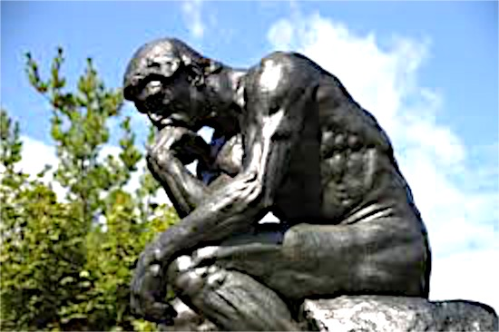
How food becomes you-in review
Digest…..breakdown whole food
Absorb….transfer nutrients into blood
Transport…. move nutrients to cells
Metabolize….cell use or store nutrients
Think Before You Eat…!
Notes:
Remember you REALLY ARE what you eat…so think before you put something in your mouth to eat!

