Slide 1
Nutrition 10
Today Thurs. May 11
  Download My Fitness Pal
  Finish Diabetes
  Overview Protein Calorie Estimate and Diet Assignment
Tues. May 16
  Topic: Protein
  Protein Calorie Estimate Due
Thurs. May 18 NO Nutrition 10 CLASS

Slide 2
How many Calories do I need?
Basal Metabolic Rate (BMR)
  Calories required to run basic body functions
  Measure when fasting (12 hr.), resting quietly
  Age, gender, diet history, health, size all influence
Activity
  All conscious physical activity (e.g. brush, playing ball, tying shoe laces)
Thermogenesis
  cost to utilize food
Notes:
Highest requirements for protein and calories are when when we are infants. Never again to we have needs that high on a per pound body weight basis.

Slide 3
Protein needs.
Less than you think!
Average person needs ~half their
weight in grams of protein/day.
~0.5 g/pound body wt. (range 0.4 - 0.9g/lbs.)
  Wt. 150lbs. → Need ~75 grams
  Wt. 150lbs. → Need ~125 grams
!!!Excess protein is NOT stored as protein. It is converted to fat for storage!!!

Slide 4
Protein & Calorie Estimate Activity
Activity purpose:
Review factors that influence your daily protein and calorie needs (read HO)
Use common tools to calculate your protein/ calorie needs.
Hand-out posted online. Start in class. Due May16
Hand-written OK as long as it’s easily legible!

Slide 5

Diet Assignment
Purpose:
  Familiarize yourself with logging intake
  Identify strengths/weaknesses of your diet
  Discover relevant food sources of nutrients
Log 3-days food intake and evaluate it.
40 points! Due Tues. May 23
Please download myfitnesspal.com app now and create an account

Slide 6
Figure Out The Amount
Use My Fitness Pal
2 C. enriched white rice, cooked
4 oz. chicken thigh, cooked, boneless, skinless
1.5 T. soy sauce
2 C. mixed dark leafy greens
5 cherry tomatoes, fresh
4 Tbsp. Ranch Dressing
¾ C. choc chip ice- cream, Breyers
Notes:
Download My Fitness Pal to use to calculate protein content of meal…or use your text or other logging app ( for example Lose It!)

Slide 7
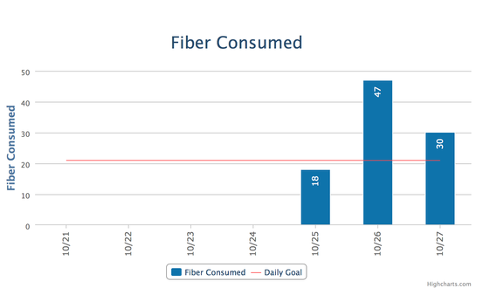
Sample ‘Report’
Eight reports: calories, protein, sat. fat, sodium, potassium, fiber, sugar, calcium
Self-calculate 3-day avg. intake for each report (iPhone app can do this too)
Print the 3 day average on each report.
3-day average fiber intake =>32g.
The red line is amount MFP advises for you

Slide 8
Sample iPhone Report-Fiber
Screen shot page
e-mail to self
cut/paste into
assignment
Average calculated
for you by iPhone app

Slide 9
Diet Assignment
40 points-same as a midterm
Due Tues. May 23
Late work not accepted
Follow directions to earn max points

