Slide 1

Nutrition 10
Today Tues. May 16
  Topic: Protein
  Protein Calorie Estimate assignment due
No class May 18
Tues May 23
  Topic: Vitamins/Minerals
  Diet Assignment due

Slide 2

Recap.….Pondering Protein
The body’s guide/blueprint for building protein is ______?
In what form is protein absorbed?
Are protein supplements needed to build muscle?
What element makes protein unique among the essential nutrients?
Why is protein a non-preferred fuel?
Can protein be used to make blood glucose?
Protein needs/lb. are highest at what stage of life?
Notes:
Some of this is review

Slide 3
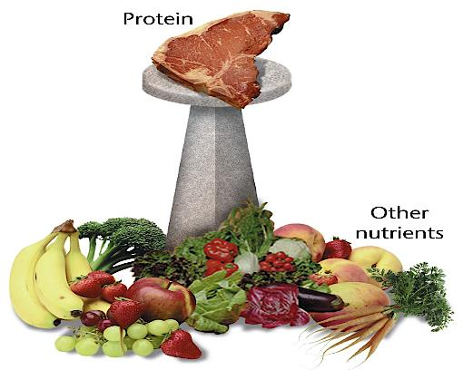
Protein
Take it off its pedestal. It’s but One Essential Nutrient
Illustration 15.1, p. 15-2
Notes:
Illustration 15.1
The protein perception.
Remember it is not the most important EN on an acute basis either

Slide 4
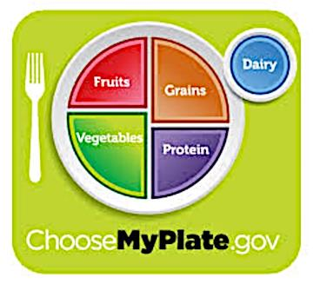
Take it off its pedestal!
Balance it with other nutrients
OK to count
starchy beans
as
Protein or Veg
OK to count quinoa
as Protein
or Grain
Illustration 15.1, p. 15-2
Notes:
See link for more on USDA the Plate Method and portion sizes
Beans can be counted as protein or vegetable.
Quinoa can be counted as protein or grain

Slide 5
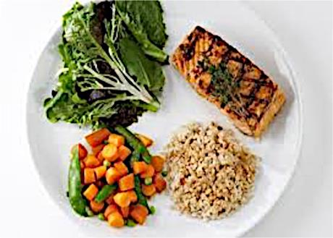
Take it off its pedestal!
Balance it with other nutrients
The USDA Plate Method
Illustration 15.1, p. 15-2
Notes:
Traditional US diet using USDA Plate Method

Slide 6
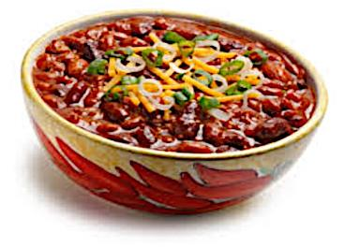
Take it off its pedestal!
Balance it with other nutrients
2/3 US protein
intake is from
animal
products
bugs provide
~10% of protein
globally!
Where do we find most protein?
Meat, cheese, eggs, veg (especially
beans), seeds, nuts, grains, dairy…and
Illustration 15.1, p. 15-2
Notes:
Vegetarian approach to USDA Plate Method. Beans (low fat protein, veggie, complex carb) + tomatoes, onions, peppers (veg) + small amt. of cheese (high fat protein). Spiders have more protein/unit weight than any other bug. Grasshoppers are 15-60% protein/weight
Protein in most foods except fruit, fats/oils, added sugars

Slide 7
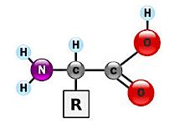
Protein is……
A building material and non-preferred fuel
Rarely in pure form e.g. egg white, some supplements
Made of 20 common amino acids
All contain nitrogen (as NH₂)
9 essential (Essential AA)
11 non-essential (Non Essential AA)
Conditionally essential AAs
Needed under certain circumstances
    critical illness…repair tissues
    Infancy….rapid growth

Slide 8

Amino Acids → Protein
Chains of AAs make up proteins
AA type/order determine protein function
DNA
  Blueprint (code) for type/order of AAs
  Code to make all proteins is in all cells, but egg/sperm
  Cell function reflects the part of DNA ‘turned on’
Gene
  The part of the DNA that codes for a specific protein e.g. insulin, glucagon, thyroxine, enzymes, etc.
  Cell function reflects which genes are ‘turned on’
Notes:
How do we know which amino acids to link together to make a certain protein? DNA has the ‘recipe or blueprint or code’ for how to do this. Tells us which AA to hook onto the growing AA chain necessary to make the protein being built.
Mutations (changes in DNA) can be good (sickle cell protects against malaria) or bad…. resulting in cancer and/or birth defects.
Note: Stem cells: can divide for long periods of time, can make many different types of cells. Two basic types, embryonic and adult. Embryonic SC can make any of ~200 cell types in the body. Adult SC generally can only make cells of type from the tissue from which it is taken e.g. blood stem cell can make one of 12 types of blood cell types. However, it seems that Adult SC can be modified in the lab to produce something called Induced Pluripotent SC ( iPSC) that make the adult SC act more like an Embryonic SC

Slide 9
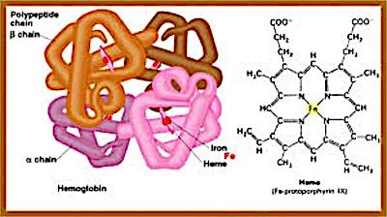
Protein on the Job (as a builder)
Hemoglobin
Some Hormones (insulin)
Enzymes, antibodies
Transporter molecules
Water balance
Notes:
If you weight 120 pounds and are ~ 60% water…72 pounds of your weight is water and 48 pounds dry weight. Of the dry weight, about 45% is protein or 22 pounds. In other words, not much of our body weight is protein (~18-20% protein)!
Water needs to be distributed appropriately throughout the body. Protein helps make this happen. If protein is absent, then water distribution is uneven wit much of water to moving to lowest point of gravity (feet and ankles). This one type of edema.
Other jobs of protein: some hormones (Insulin, glucagon, thyroxine, etc. ), transporter molecules (lipoproteins Vitamin A needs a transporter molecule, etc. ), hemoglobin is a transporter molecule (carries oxygen in the blood)

Slide 10
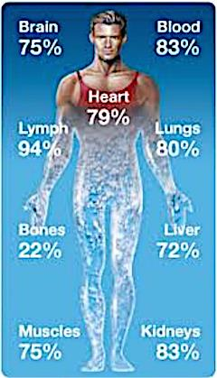
Protein on the Job (as a builder)
Some Hormones (insulin)
Enzymes, antibodies
Transporters (e.g. hemoglobin)
Water balance
Part of muscles and organs
Most abundant protein in body is collagen in skin and bone
Non-preferred jobs of protein make ATP (nrg) and glucose

Slide 11

Top priorities of body:
1. Energy
2. Glucose
Remember
Assume carb reserves are used & no dietary carb
Lipids (fats/oils) can’t be made into glucose.
If needed, protein will be used to meet glucose and energy needs, before used to build body proteins!!!
Notes:
Think twice about skipping meals, particularly before a work-out. You must have glucose on board 24/7. If you don’t eat, then body turns to its reserve glucose (glycogen) to meet its need. If no glycogen and no dietary source of glucose, then the body has to turn more and more to body protein to make glucose (sugar!)

Slide 12

What happens with excess dietary protein?
Amino group (NH₂) must be excreted in urine
  Increase need for water
  Extra kidney work
Remainder of some AA’s convert to
  Glucose or nrg (ATP), if needed
  Body fat, if it’s extra calories
Notes:
Also….if eating a high protein diet, remember, such diets are typically high in animal products which is where we get most saturated fat. A high sat fat diet is a risk factor for vascular disease (heart attack and stroke)

Slide 13
Body Energy Stores
70 kg/154 lb male
Fuel Type
Body fat 10% 20%
Glucose, blood 100 100 calories
Glycogen
liver 300-400 300-400 cal muscle 1200-1600 1200-1600 cal
Fat 63,000 126,000 cal
Protein NOT STORED
Notes:
From L. Applegate PhD. Nutrition Basics 2nd Ed
10% body fat x 154 lbs.= 15.4 lbs. of fat
15.4 lbs. x 454 grams/pound= 6992 grams
6992 grams x 9 calorie/gram of fat = 63,000 calories stored as fat.

Slide 14
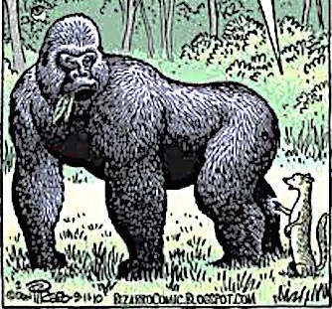
How much protein do you need?
How can a big guy like you… get the protein you need eating grass?
Not as much as you might think!
We have a remarkable capacity to recycle body proteins
Protein need (grams) is ~ half body weight in pounds.
Typical US diet has excessive protein.
Globally, this is NOT the case!
Notes:
Protein need of average person-example: If weigh150 lb.→ need ~75 g protein. This is a high estimate I use because it is easy to remember. Using the actual recommendation, a 150 lb. adult would need only 60 g, plus there is a huge safety factor built into this number as well.
There are about 30 grams/oz. 1 oz. meat, cheese, 1 egg or 1 C of milk has 7 -8 grams of protein in it
Like dogs, we are omnivores and can get this from plants and animal foods. Omnivores eat everything, but most of us (like our dogs) enjoy meat. Why? Because typically it is loaded with fat which is tasty and calorie dense.
Highest protein recommendation per unit weight is for infants!
Adult sedentary Recommended Dietary Allowance (RDA) ~ .4-.5 g/lb. or .8g/kg Max we can use as protein 0.9 g/ pound or 2 gram/kg!!!

Slide 15
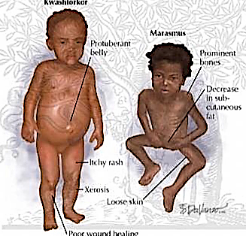
Malnutrition-‘bad’ nutrition
Primary cause→ poverty
In developed world, problem is over-nutrition
In developing world problem is under-nutrition
  Kwashiorkor
  Marasmus
Notes:
Malnutrition is the most important risk factor for the burden of disease in developing countries. It is the direct cause of about 300 000 deaths per year and is indirectly responsible for about half of all deaths in young children
Worldwide, an estimated 852 million people were undernourished in 2000–2002, with most (815 million) living in developing countries. The absolute number of cases has changed little over the last decade. However, while China had major reductions in its number of cases of protein– energy malnutrition during this period, this was balanced by a corresponding increase in the rest of the developing world.
Underweight– low weight for age
Stunting- low height for age
Wasting- low weight for height

Slide 16
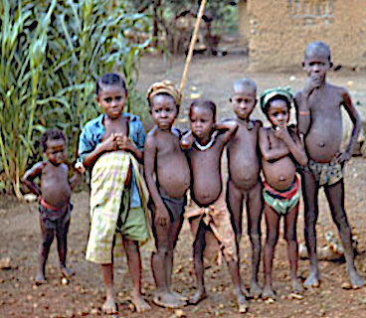
Kwashiorkor
  Bloated belly, ankles, feet=>edema
  Edema=>abnormal water storage
  Inefficient use of protein and fat
Notes:
Sierra Leone photo. All kids with protein malnutrition. Staple is adequate in calories, but not high enough in protein to meet their needs. Staple is often cassava, yams or plantain. High starch, low protein. Adults can enough of these foods to meet their needs, but kids cannot (needs high, stomachs small) and are at highest risk of deficiency.

Slide 17
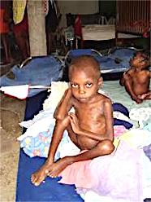

Marasmus
  Protein Calorie Malnutrition (PCM)
  Severe ‘wasting’ disease
  Developing countries…starvation
  Developed countries…..anorexic, cancer patients, end stage AIDS
  Emaciated appearance
  Same consequences
  …...........different cause!
Notes:
Remember cells in a person with poorly controlled diabetes act a lot like cells of a starving person. Diabetes, glucose does get into the cell (BSL high) Starvation, there is little if any glucose to get into the cell (body struggling to keep BSL normal. It most certainly is not high)

Slide 18
Recap.….Pondering Protein
The body’s guide/blueprint for building protein is ______?
In what form is protein absorbed?
Are protein supplements needed to build muscle?
What element makes protein unique among the essential nutrients?
Why is protein a non-preferred fuel?
Can protein be used to make blood glucose?
Protein needs/lb. are highest at what stage of life?
Notes:
Some of this is review

