Slide 1

College Planning Committee Updates
Spring 2018

Slide 2
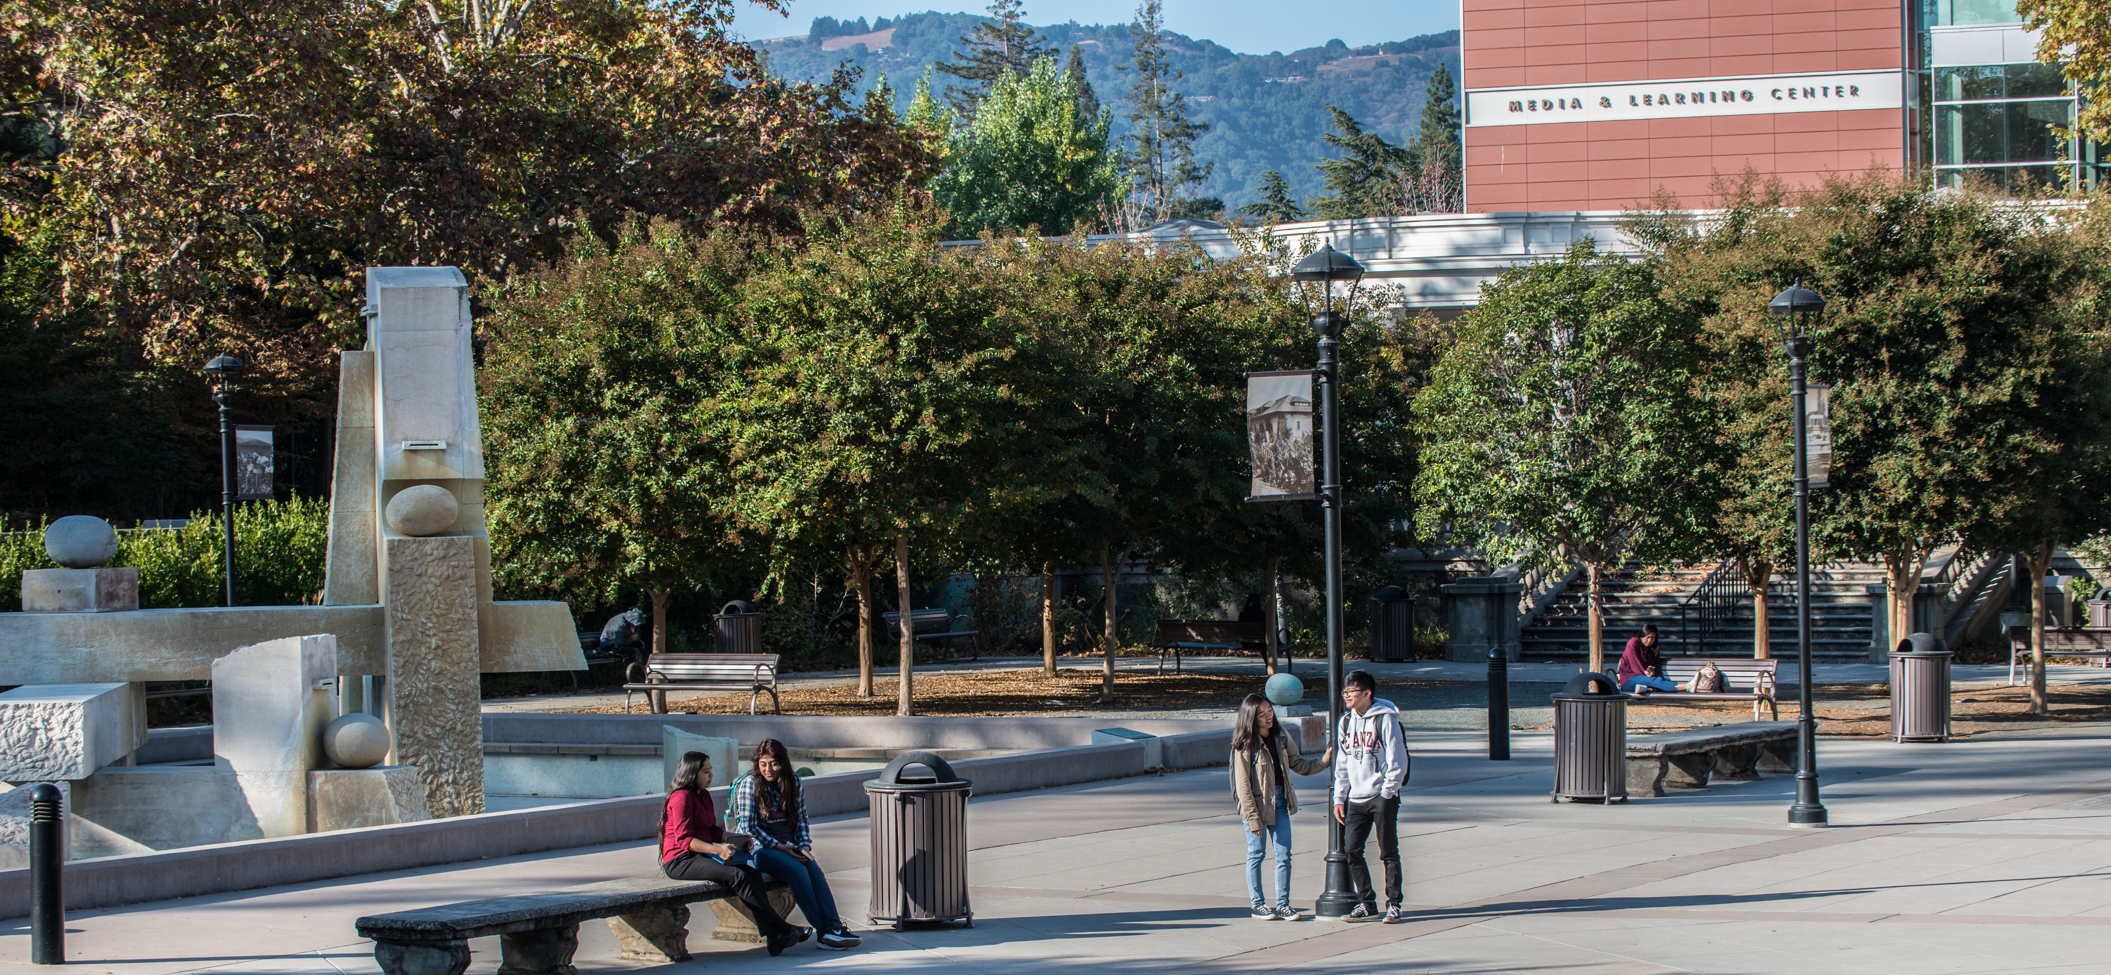
Spring 2018
Review key external and internal trends
Review mission statement and strategic initiatives
Develop a vision statement
Conduct collegewide dialogue and activities around the mission, vision and strategic initiatives

Slide 3
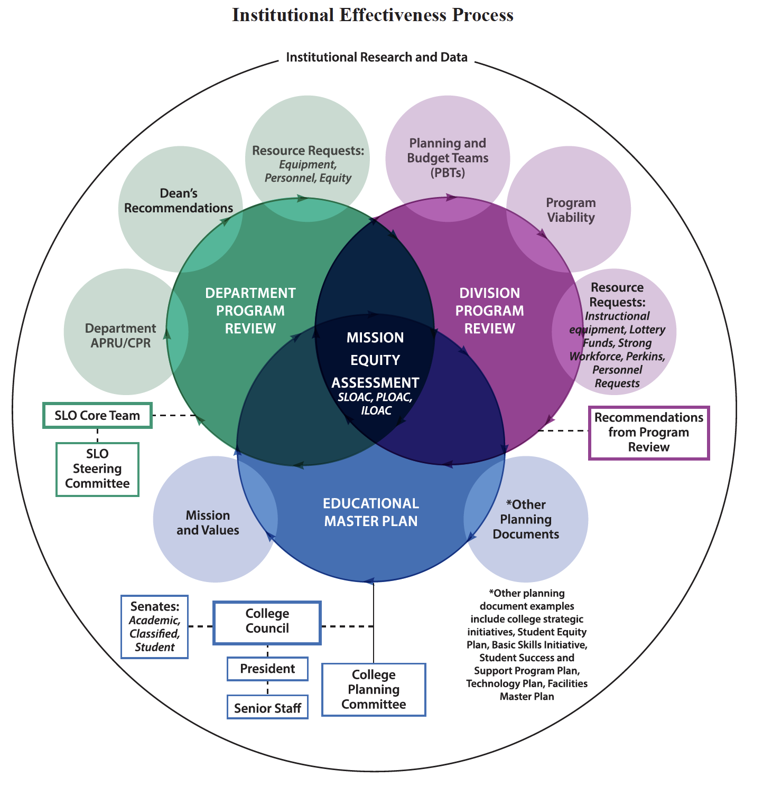
Spring 2018

Slide 4
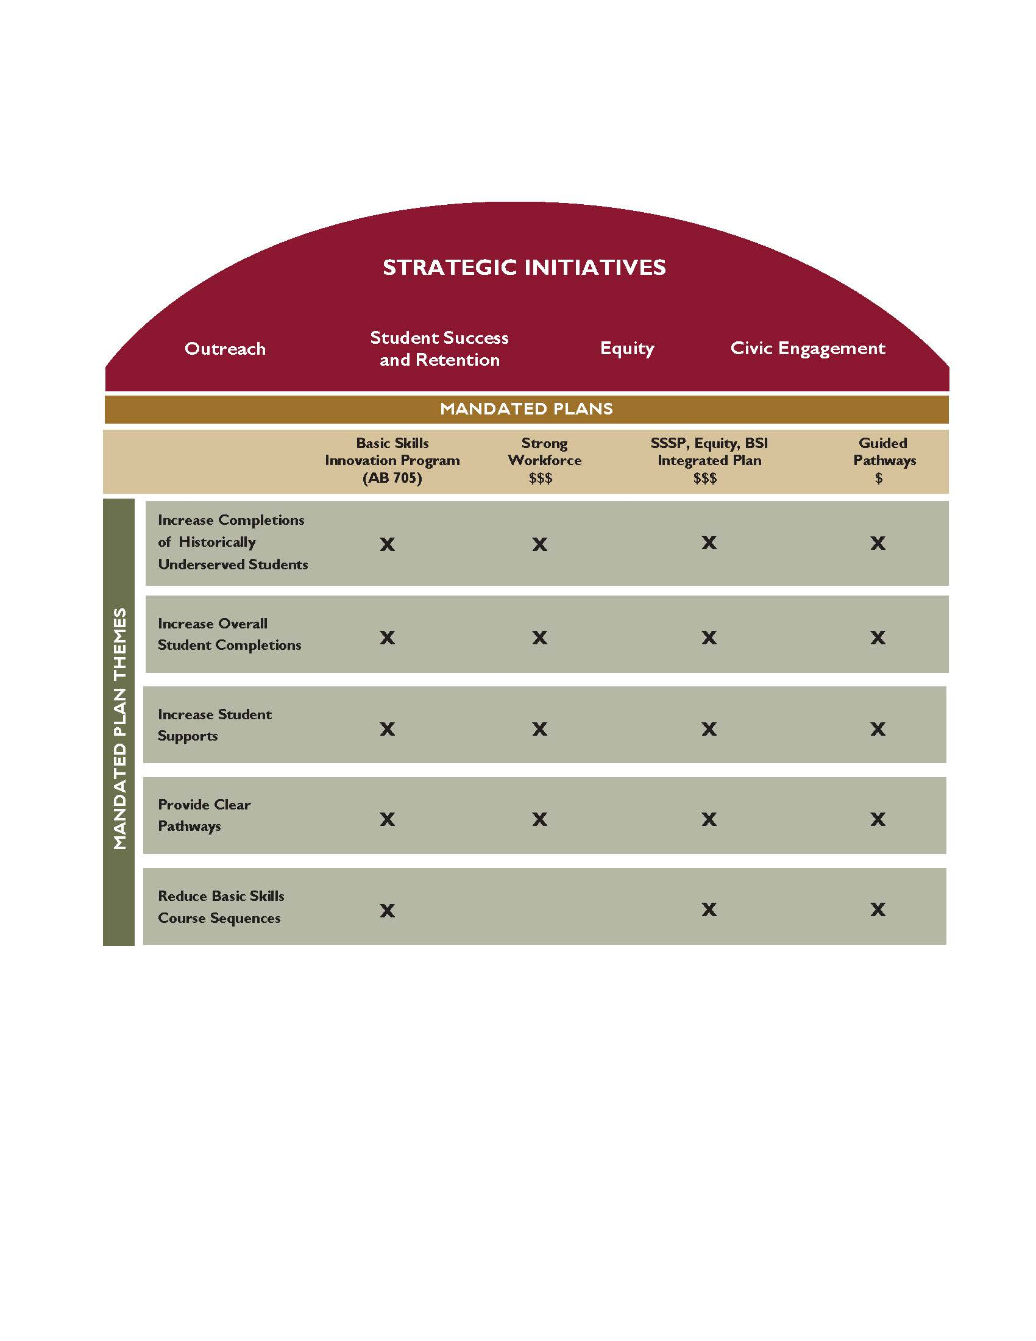

Slide 5
State of the Valley 2018
https://jointventure.org/events/state-of-the-valley

Slide 6
Age + High School Graduates
Age
17 and under decreased by 0.2%
18-24 decreased by 1.5%
65 and older increased by 1.5%
Birth rates peaked 18 years ago and consistently decreased through 2017
High School Graduates
10% of students do not complete high school,
down from 12% six years ago
54% are not eligible for UC or CSU – increased from 47% six years ago

Slide 7
Employment
Unemployment at 3%
  Latina/o and African American residents continue to comprise the largest unemployed group
50% of all jobs are in Community Infrastructure and Services (+23%) (healthcare, social services, retail, food services, education, construction, transportation, banking, warehousing and storage)
  26% (+35%) in Innovation and Information Products and Services (technical research, software, telecommunications manufacturing, pharmaceuticals, biotechnology, I.T. repair services)
  16% (+21%) in Business Infrastructure and Services (engineering, goods movement, legal, investment and employer insurance, marketing, advertising, public relations)

Slide 8
Housing + Commuting
Housing
Median home price +7% in 2017 = $968,000
  Highest in nation
Rental costs are flat
Rise in multigenerational households between 18-40 years old
  More young adults living at home
Commuting
+17% in commute times = additional 43 minutes per commuter
70% drive alone
Public transportation use down 15%

Slide 9
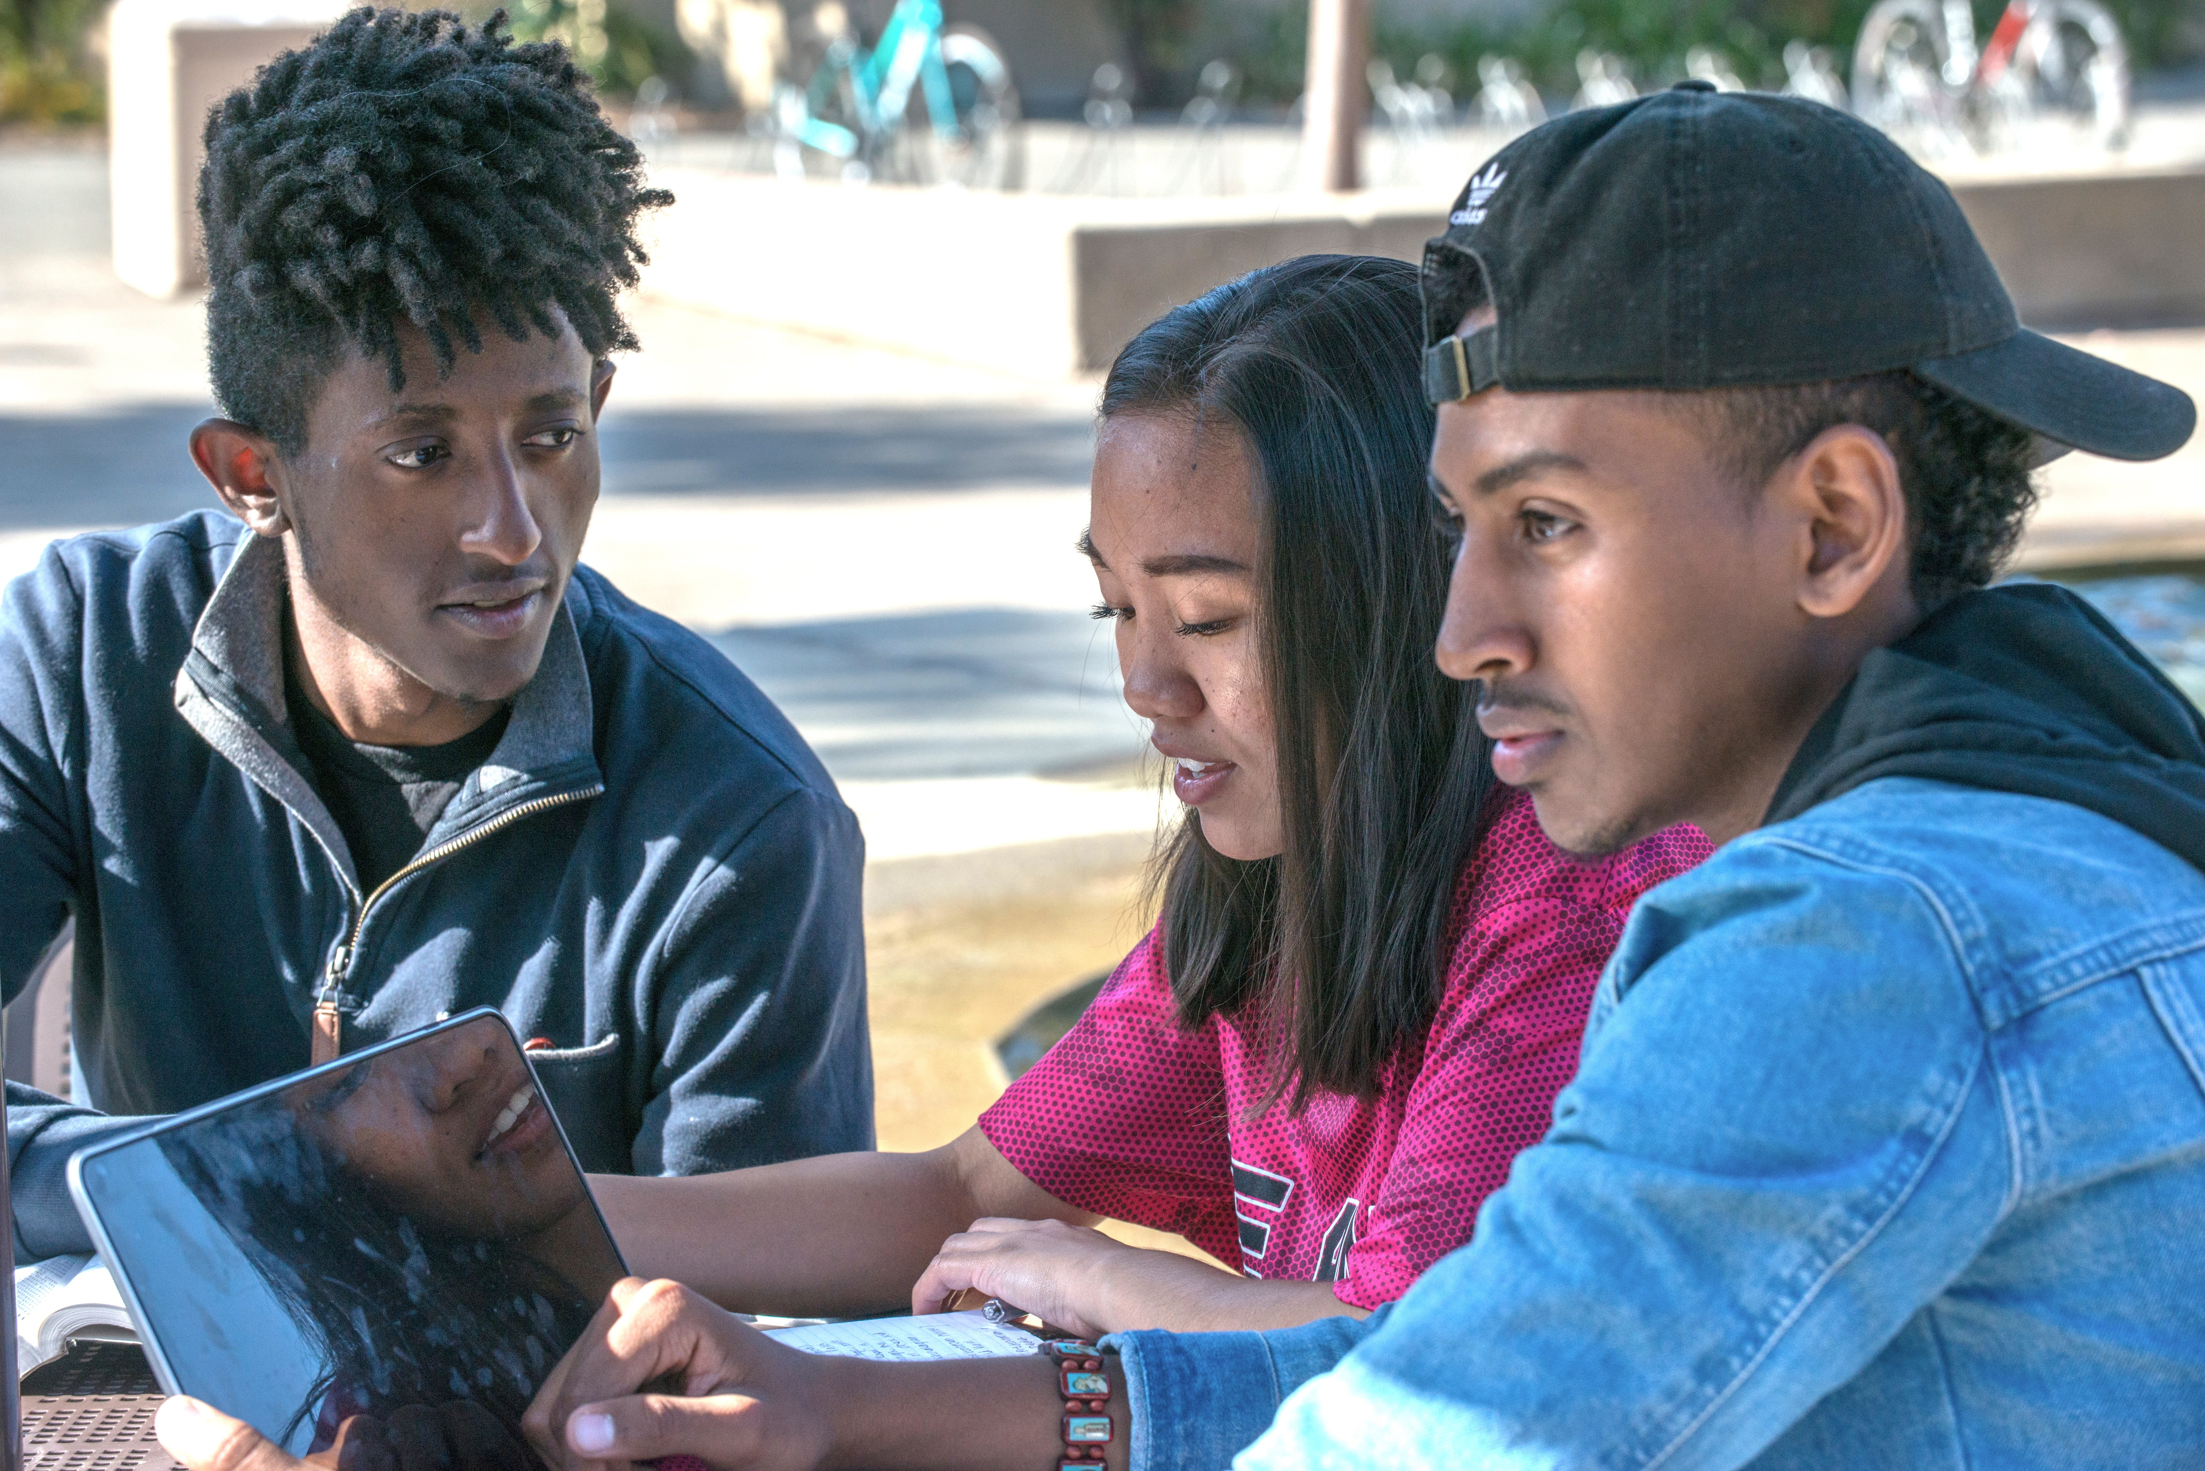
Poverty
High-income, low-poverty region – 8.6% poverty rate compared to 14.4% in California
  Poverty rate is three times higher for minority groups
1 in 10 children live in poverty
More than 1/3 of students ages 5-17 receive free or reduced-price school meals
30% of all households do not earn enough money to meet their basic needs without public or private assistance

Slide 10
What does this mean for us?
Fewer college-aged students in the Valley is an ongoing trend
  What enrollment number is sustainable in light of the continued enrollment reductions?
  As fewer students are eligible for a state university, how can we get them to enroll here?
Commute times continue to grow
  What can we do as a college to help students, faculty and staff in this area?
Wage growth has not kept pace with inflation
    What services can we provide to students and their families to ensure their basic needs are met while attending De Anza?
Largest area of employment growth: innovation and information products and services
  Are we aligning with employment growth in the Valley, including through liberal education, transfer preparation and degrees, and career technical education?

Slide 11
Vision, Values and Mission

Slide 12
Vision Statement - Draft
“Empower all student to attain their educational goal, develop an equity-based mindset, and become civic leaders in their community.”

Slide 13
Values
Expanded Values Statement

Slide 14
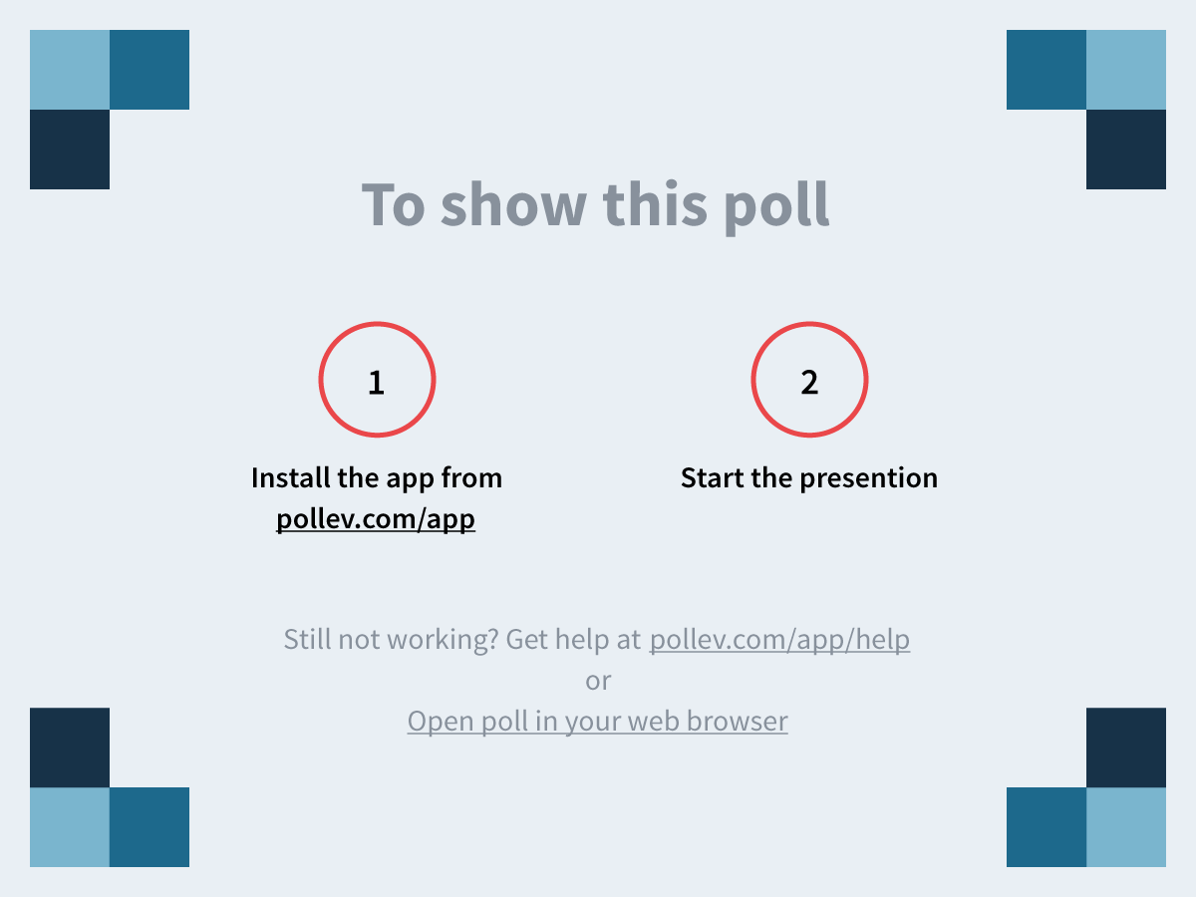
Notes:
What does "De Anza College" represent to you?
https://www.polleverywhere.com/free_text_polls/Zlod9WltVy3Hmo2

Slide 15
Mission Statement
De Anza College provides an academically rich, multicultural learning environment that challenges students of every background to develop their intellect, character and abilities; to realize their goals; and to be socially responsible leaders in their communities, the nation and the world. The college engages students in creative work that demonstrates the knowledge, skills and attitudes contained within the college’s Institutional Core Competencies:
Communication and expression
Information literacy
Physical/mental wellness and personal responsibility
Civic capacity for global, cultural, social and environmental justice
Critical thinking

Slide 16
Next Steps
Review feedback from shared governance groups
Circulate revised or reaffirmed mission, vision and strategic initiatives to governance groups for adoption in early fall 2018
Provide feedback to your college planning committee representative or to Newellmallory@deanza.edu

Slide 17
College Planning Committee Updates
Spring 2018

