Slide 1

We’re on the Web!
www.deanza.edu/slo/
Welcome to 3rd Annual
SLO Convocation
Welcome from the SLO Team:
Randy Bryant, Jim Haynes, Anu Khanna, Coleen Lee-Wheat, Mary Pape,
Toño Ramirez
Assisted by:
Cynthia Kaufman, Veronica Neal, Jackie Reza
SLOAC

Slide 2

De Anza College provides an academically rich, multicultural learning environment that challenges students of every background to develop their intellect, character and abilities; to realize their goals; and to be socially responsible leaders in their communities, the nation and the world.
Our Mission

Slide 3
De Anza College fulfills its mission by engaging students in creative work that demonstrates the knowledge, skills and attitudes contained within the college’s Institutional Core Competencies:
Our Mission
Critical thinking Assessed 2012-13
Communication and expression
Information literacy
Physical/mental wellness and personal responsibility
Global, cultural, social and environmental awareness

Slide 4
Characteristics of
Global, cultural, social and environmental awareness
Students will:
Recognize their role as local, national, and global citizens
Participate in a democratic process
Respect social and cultural diversity
Appreciate the complexity of the physical world
Understand the significance of both environmental sustainability and social justice

Slide 5
Global, cultural, social and environmental awareness
Timeliness – point #1
Student Respondents to the Community College Engagement Survey stated their experience at De Anza “very much” or “quite a bit” increased their ability to:
Critical Thinking: able to evaluate conclusions to ensure they make sense | 63%
Information Literacy: able to recognize when additional information is needed to complete an assignment | 65%
GCSEA: work effectively individually and collaboratively on projects | 57%
GCSEA: participate in a democratic process | 38%
GCSEA: understand the significance of both environmental sustainability and social justice | 52%

Slide 6
Global, cultural, social and environmental awareness
Timeliness – point #2
The most recent Accountability Reporting for the Community Colleges (ARCC) report showed that we have lost ground in closing the gap for the underrepresented. See slide 9 at http://www.research.fhda.edu/documents/2012ARCCBoardPresentationv3.pdf

Slide 7
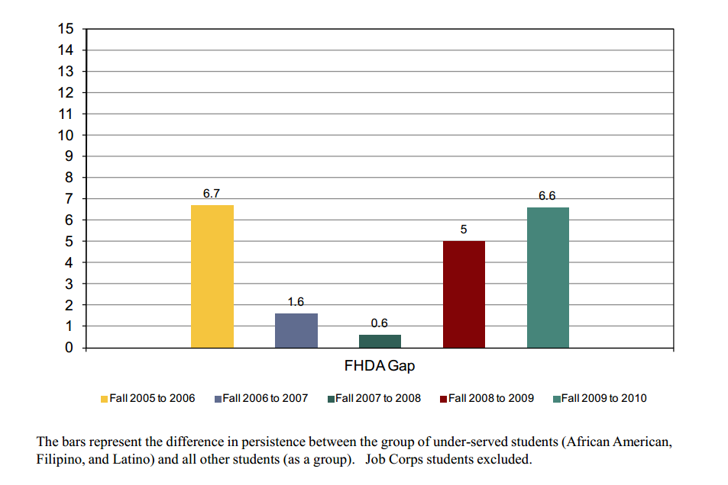
Growing Equity Gap

Slide 8
Global, cultural, social and environmental awareness
Timeliness – point #3
Campus Climate survey will be conducted in Spring 2013

Slide 9
GLOBAL AWARENESS

Slide 10
GLOBAL AWARENESS
CULTURAL AWARENESS

Slide 11
GLOBAL AWARENESS
CULTURAL AWARENESS
SOCIAL AWARENESS

Slide 12
GLOBAL AWARENESS
CULTURAL AWARENESS
SOCIAL AWARENESS
ENVIRONMENTAL
AWARENESS

Slide 13
Cultural Awareness
Global Awareness
Civic Capacity for
Equity
and
Social Justice
Social Awareness
Environmental Awareness

Slide 14
Faculty & Staff Focused Objective:
Deepen faculty and staff understanding of global, cultural, social, and environmental awareness seen through the lens of civic capacity for equity and social justice.

Slide 15
Student Focused Objective:
Assess that our students are deepening their awareness in regards to global, cultural, social and environmental issues as seen through the lens of civic capacity for equity and social justice

Slide 16
Division__________________ Department/Service Area _____________________
In the table below choose one or more characteristics of this ICC and write what you currently do or what you propose to do in your class(es) or service area.
ICC Characteristic | Considering your course/program what do you or did you observe could be done to deepen (Global/Cultural/Social/Environmental)nga? | What was the experiment/assessment that you tried or you will try?? | How will you know that students “got it”, i.e. students’ Global/Cultural/Social/Environmental Awareness deepened.
Global Awareness
Cultural Awareness
Social Awareness
Environmental Awareness
Name: ____________________ (Optional but we would really appreciate it!)

Slide 17
We’re on the Web!
www.deanza.edu/slo/
Thank you
SLO Convocation
Outcome #2 | Faculty will dialog on SLO work at course and program level
1:00—3:00 pm | - Individual Department work: SLOs, SLOACs, PLOACs, APRU - Drop-in Help available in ADM 102
SLOAC

